Slide 1

A Geographic-Customer sentiment analysis on airlines using NLP Techniques
Jampani Venkata Pavani
W9577649

Slide 2
Agenda
Introduction
Aim and Objectives
Methods Used
Results and Analysis
Conclusions
References

Slide 3
Introduction
Finding the positive and negative sentiments that customers have expressed in their feedback is an essential component of customer sentiment analysis for airlines.
Airlines are able to determine total customer satisfaction by using NLP algorithms that are taught to identify sentiment indicators, such as emotions, opinions, and attitudes (Patel et al. 2023).
This study uses NLP techniques to extract nuanced attitudes related to in-flight amenities, customer service, booking, and check-in, among other components of the airline experience.

Slide 4
Aim and Objectives
Aim
The aim of this work is to develop a Airline Sentiment Predictive model to analyze the Airline Tweets and Feedbacks to gain insights about the customer experience and across the Airline Industry.

Slide 5
Aim and Objectives
Objectives
To develop a sentiment analysis predictive model in order to examine customer reviews related to Airline service providers.
To utilize the sentiment analysis to gain insights to identify specific areas of improvement such as flight experience, baggage handling and customer service interactions.
To analyse sentiments across the different airlines, present in the dataset and gain insights about the customer perception towards different airline service providers.
To explore if Tweet Location has influence on sentiment to understand the regional variations in customer perceptions.
To explore various Machine Learning Algorithm in developing the Predictive Model and select the best performing model.

Slide 6
Methods Used
Natural Language Processing (NLP)
NLP is situated at the intersection of linguistics, AI, and computer science, seeks to equip machines with the capability to comprehend human language.
Its goal is to establish a link between the intricate nuances of human communication and the organized realm of computational analysis, primarily through syntax and semantic analysis.
Syntax, functioning like a blueprint, shapes the arrangement of words, influencing grammar and coherence.
Ensemble Techniques
Ensemble Techniques, in synergy with NLP, emerge as a potent force in airline Customer Sentiment Analysis, showcasing remarkable predictive prowess.
NLP, adept at deciphering nuanced language intricacies, seamlessly aligns with understanding client sentiments.
Techniques like bagging, stacking, and boosting amplify NLP's effectiveness in deriving practical insights (Ganaie et al., 2022).

Slide 7
Methods Used
Random Forest Algorithm
The adoption of the Random Forest Algorithm presents a potent strategy seamlessly integrating with NLP approaches for customer sentiment analysis in the airline industry.
This robust ensemble learning algorithm, known as Random Forest, employs a multidimensional approach to enhance precision and interpretability in sentiment analysis results (Aria et al., 2021).
The core of the Random Forest approach involves constructing a collection of decision trees, each trained on different subsets of the dataset.
Gradient Boosting and Extreme Boosting Techniques
Gradient Boosting and Extreme Boosting Techniques are pivotal in Customer Sentiment Analysis in the airline industry, seamlessly integrating with NLP techniques (Wankhade et al., 2022).
These sophisticated algorithms enhance precision and broaden insights, fortifying sentiment analysis.
Gradient boosting, a potent ensemble technique, constructs a series of models, each correcting the flaws of its predecessor, resembling an ongoing learning process.

Slide 8
Methods Used
Ada Boosting Algorithm
Airlines now possess potent sentiment analysis capabilities, thanks to the synergy of gradient boosting and extreme boosting with NLP approaches.
These computers excel at spotting nuanced linguistic indicators, discerning both overt and covert emotions in consumer reviews (Downie, 2019).
Airlines gain valuable insights by combining these methodologies, allowing them to customize their strategy, enhance services, and meet customer needs effectively.
Decision Tree
The strategic fusion of Decision Trees with NLP Techniques emerges as a compelling methodology that allows airlines to delve into the intricate realm of client sentiments in the dynamic environment of customer sentiment analysis within the aviation industry.
Decision Trees are algorithmic structures that systematically analyze data by making a series of binary judgments (Budhiraja and Sharma, 2023). They are often likened to investigative agents.

Slide 9
Results and Analysis
Steps involved in the Execution
Step 5: After the exploratory data analysis the data preprocessing is carried out to make the data appropriate format for the algorithms implementation.
Step 6: Applying the Vectorization technique to convert the text into numerical vector representation.
Steps 7: Applying the numerically transformed data to different algorithms like Logistic regression, support vector machine and etc.
Step 8: The model on the training data and testing the model on the testing data.
Step 9: In this stage the performance of different algorithms are evaluated and compared to select the best performing model.
Step 1: In this project Jupiter notebook is utilized for programming the model development. Different libraries required for the model implementation and data visualization are imported.
Step 2: A suitable data set for carrying out the sentiment analysis is collected.
Step 3: The collected data is then put through data cleaning to handle the missing values and so on.
Step 4: Performing the exploratory data analysis to gain and understanding about the variables and identify any trends using the different kind of visualization.

Slide 10
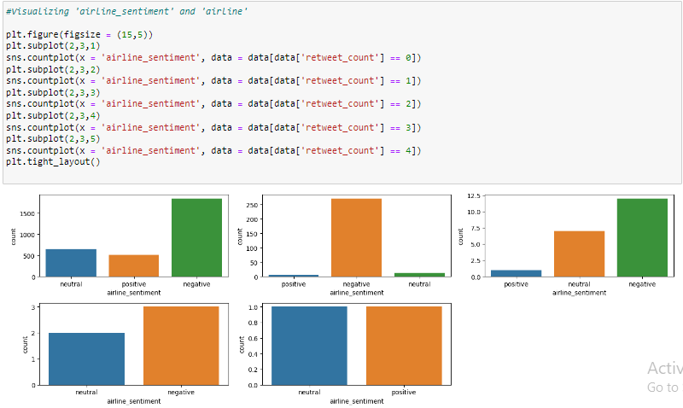
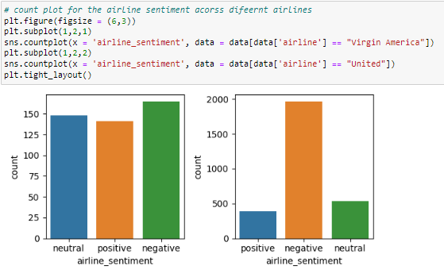
Results and Analysis
Sentiment across different retweets count
Sentiment across Airlines

Slide 11
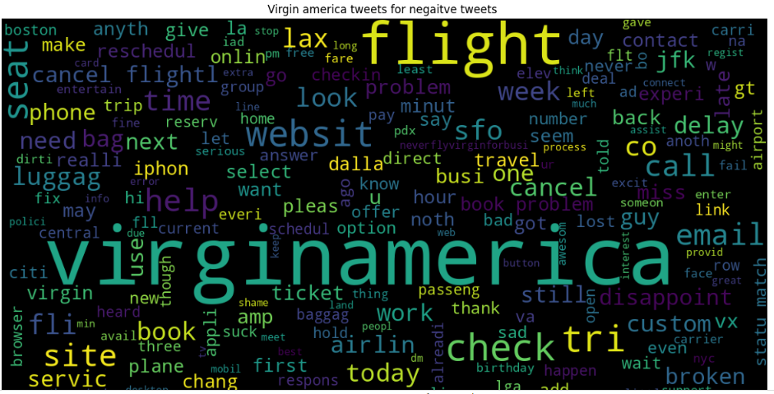
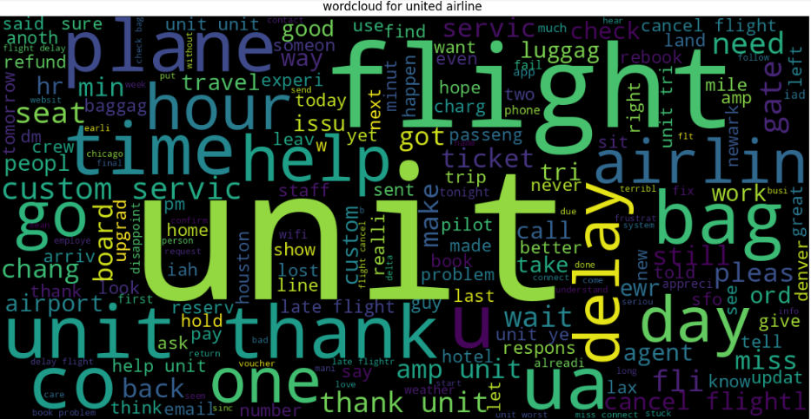
Results and Analysis
Word Cloud for Negative Tweets of Virgin America Airline
Word Cloud for Tweets of United Airline

Slide 12
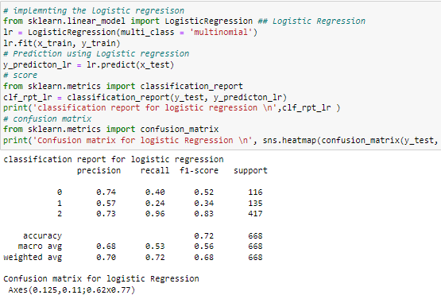
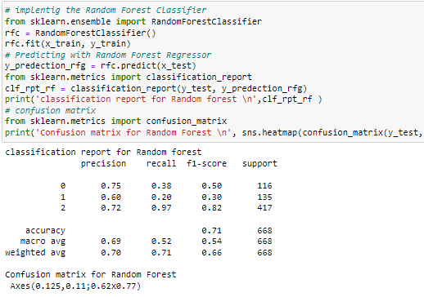
Results and Analysis
Logistic Regression Implementation
Random Forest classifier

Slide 13
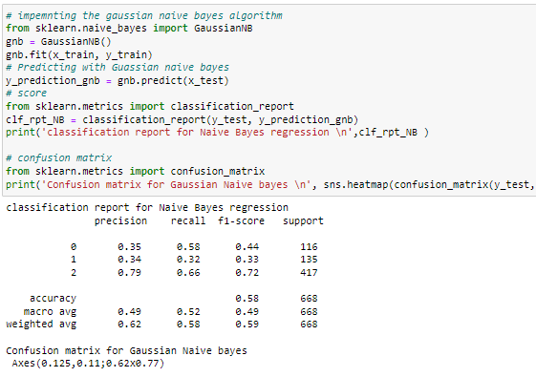
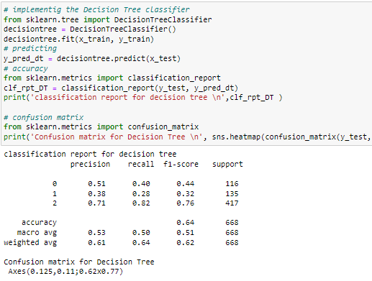
Results and Analysis
Gaussian Naïve Bayes
Decision Tree Classifier

Slide 14
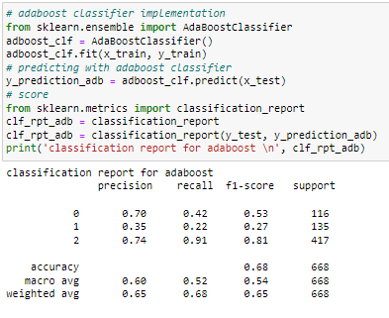
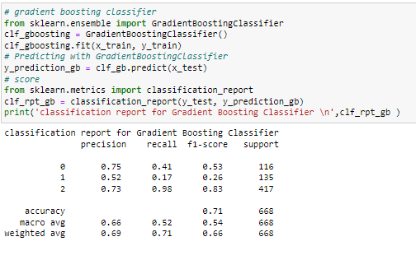
Results and Analysis
Ada boost Classifier for Sentiment Analysis
Gradient Boosting Classifier

Slide 15
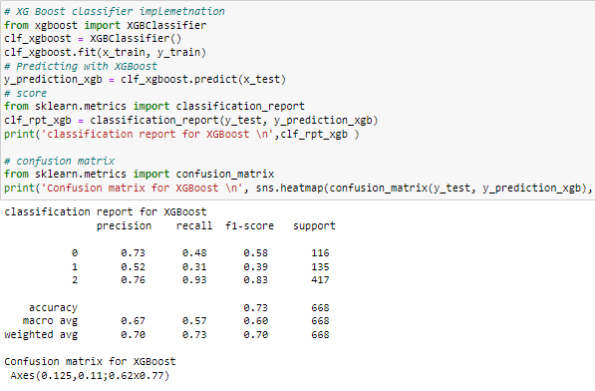
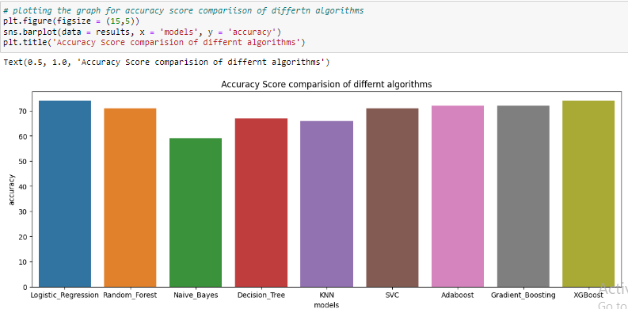
Results and Analysis
XG Boost Classifier
Comparison of Accuracy scores of Various Algorithms

Slide 16
Conclusions
This study was driven by its main goal into the field of machine learning algorithms, where a thorough analysis of several models was conducted.
Exploring a wide range of methods, the study included logistic regression, random forest, naive bayes, decision tree, k-nearest neighbors (KNN), support vector classifier (SVC), AdaBoost, gradient boosting, and XGBoost.
By taking into account a wide range of predictive modelling tools, the study went beyond traditional methods. The meticulous evaluation process led to the selection of logistic regression and XGBoost, boasting a commendable 74% accuracy rate.
This strategic selection not only attests to the author's keen understanding of algorithmic performance but also positions the models as robust tools for predictive analytics in the airline industry.

Slide 17
References
Budhiraja, A. and Sharma, K., 2023, April. Decisions Prediction Techniques Using Language Processing and Learning Algorithms. In Proceedings of 3rd International Conference on Artificial Intelligence: Advances and Applications: ICAIAA 2022 (pp. 107-121). Singapore: Springer Nature Singapore.
Downie, J., 2019. Interpreters vs machines: can interpreters survive in an AI-dominated world?. Routledge.
Ganaie, M.A., Hu, M., Malik, A.K., Tanveer, M. and Suganthan, P.N., 2022. Ensemble deep learning: A review. Engineering Applications of Artificial Intelligence, 115, p.105151.
Patel, A., Oza, P. and Agrawal, S., 2023. Sentiment Analysis of Customer Feedback and Reviews for Airline Services using Language Representation Model. Procedia Computer Science, 218, pp.2459-2467.
Wankhade, M., Rao, A.C.S. and Kulkarni, C., 2022. A survey on sentiment analysis methods, applications, and challenges. Artificial Intelligence Review, 55(7), pp.5731-5780.

